Slide 1
MORGAN HILL DEMOGRAPHICS
Incorporated: 1906
Population: 45,342
Under 18 25.9%
Foreign Born 20.1%
Language other than English: 30.9%
Registered Voters: 22,543
Veterans: 1,910
Bachelor’s Degree or Higher: 44.3%
Median Household Income: $139,161

Slide 2
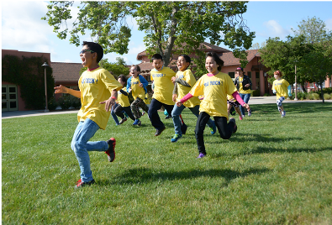
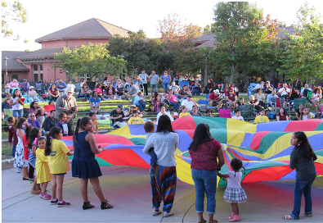
MORGAN HILL DEMOGRAPHICS
White: 44.1%
Hispanic: 34.7%
Asian: 15.8%
Black: 1.5%
Women: 52.6%
Median Age: 39.3
Median Household 3.10
Mean travel time to work 36 min

Slide 3
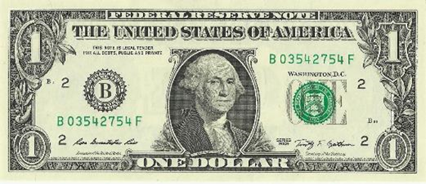
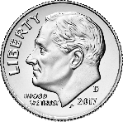
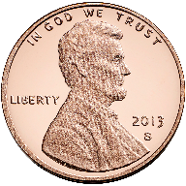
TAX COLLECTION 101
Residents & Visitors Pay
Morgan Hill Receives
Property Tax
Sales Tax
TOT
(Transient Occupancy Tax)

Slide 4
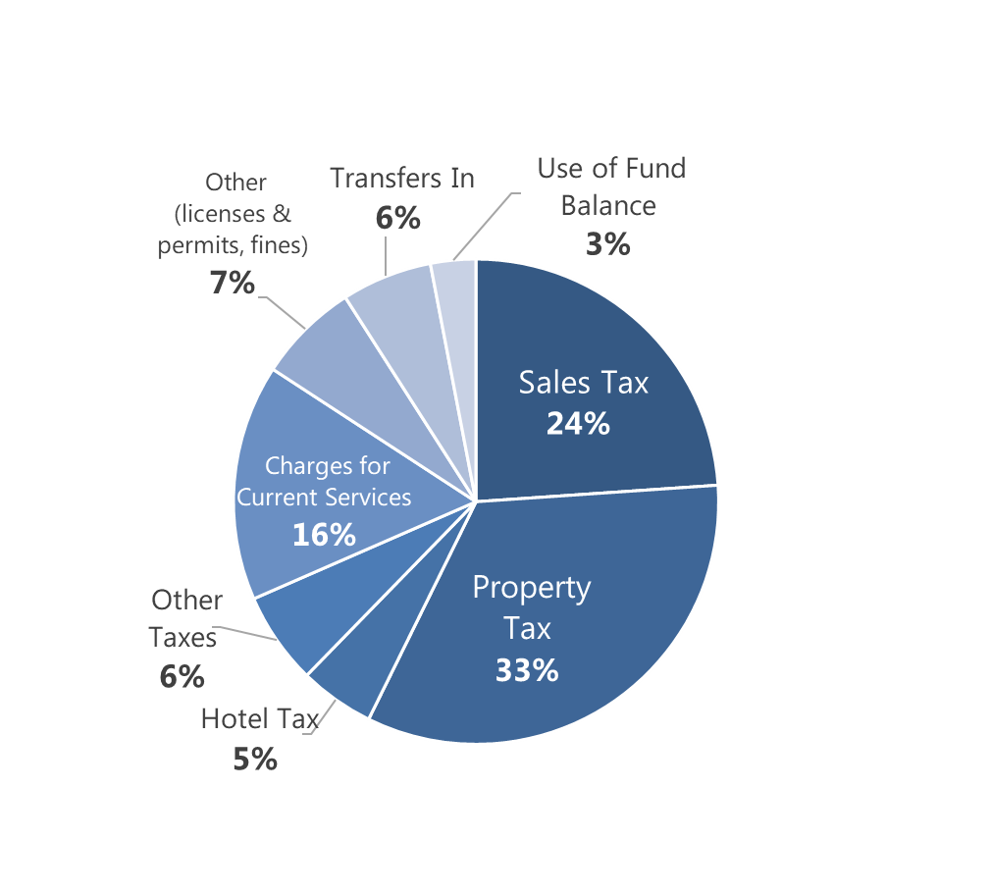
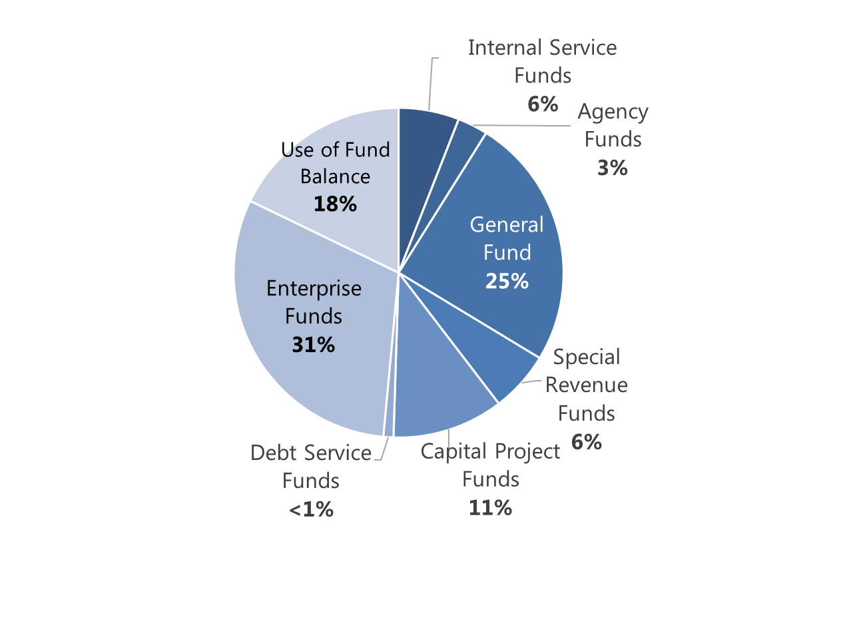
BUDGET
City Revenue
General Fund Revenue

Slide 5
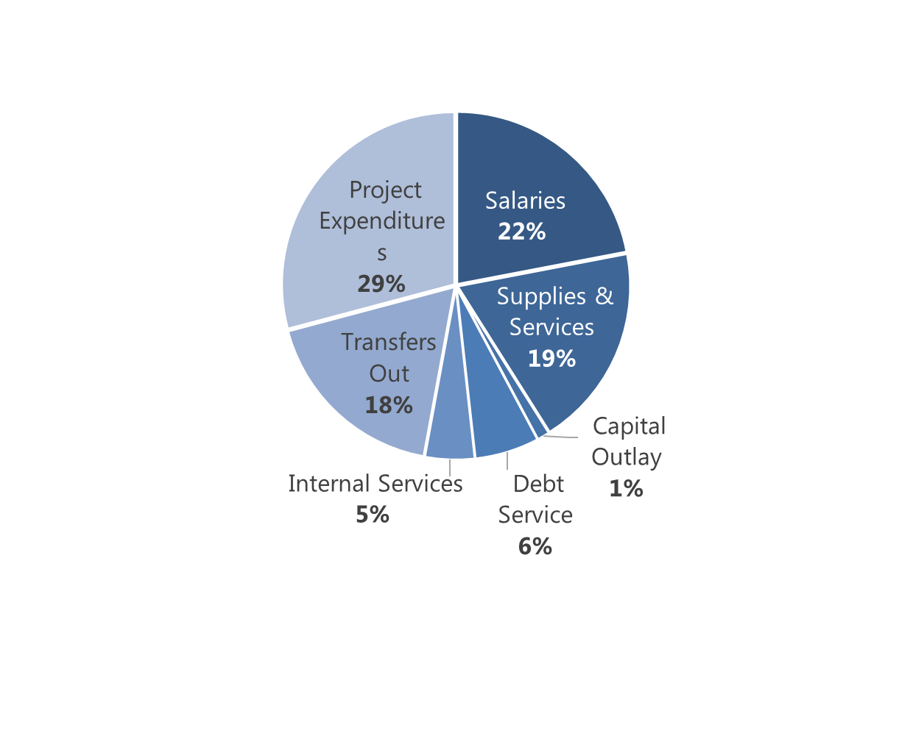
BUDGET
Expenditures

Slide 6
GENERAL FUND SIX YEAR FORECAST

Slide 7
Per Capita Discretionary Tax Revenue Comparison

Slide 8
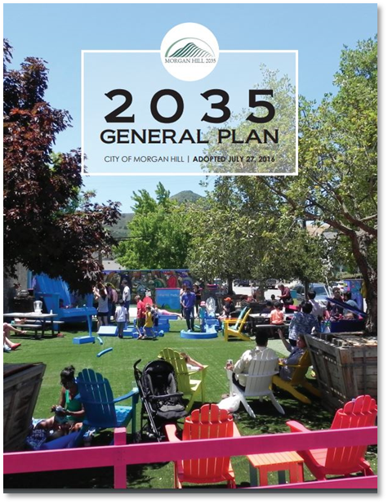
GENERAL PLAN
The Economic Development Element establishes policy guidance to support the community’s economic well-being. Its strategies include diversifying the local economy, increasing the quality and quantity of available job opportunities, decreasing the need for commuting, creating a thriving Downtown, and enhancing Morgan Hill’s appeal as a tourist destination.
Develop & maintain high-quality public infrastructure & services
Position Morgan Hill as a compelling choice for companies by providing flexibility
Retain and attract businesses by providing a business-friendly climate
Create fiscal sustainability by cultivating a diversified tax base
Increase economic opportunities through a robust and diverse range of business activity

Slide 9
SUSTAINABLE MORGAN HILL
Vision: To sustain a safe, inclusive, socially responsible, environmentally conscious, and economically sound community..
City Council Strategic Priorities:
Fiscal Sustainability
Affordable Housing and Homelessness
Community Outreach, Engagement and Messaging
Economic Development
Transportation

Slide 10
A CLEAR VISION FOR ECONOMIC DEVELOPMENT

Slide 11
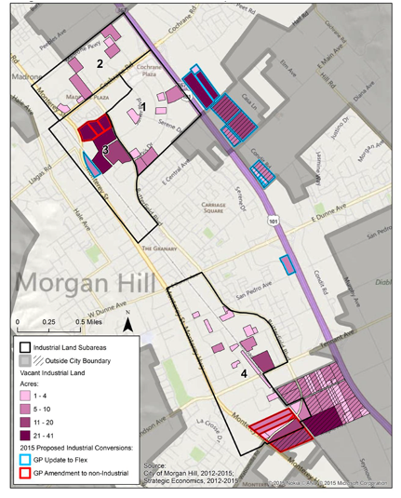
JOBS AND INDUSTRY
7.5M SF of built Industrial Space
21,796 employed residents
20% employed in manufacturing
74.9% of Morgan Hill residents commute for work
Over 1,400 businesses in Morgan Hill
1/3 of Morgan Hill firms are women-owned
3.2% Unemployment Rate

Slide 12
INDUSTRIAL MARKET
Strategic Economic Study
Morgan Hill continues to be an attractive destination for industrial users, including manufacturers, machine shops, and assembly businesses.
Morgan Hill Ranch and Madrone Business Parks continue to be the strongest location for future industrial, R&D, and warehouse uses.
Demand for industrial buildings has outpaced building supply for manufacturing, machining, and assembly businesses.
Morgan Hill firms have left to expand elsewhere, due to lack of industrial space availability.
New construction is expensive and takes approximately 2 years to complete (plan, permit, construct).
Today, there are only 92.5 acres of industrial (employment) land remaining (vacant).
86.5 acres Light Industrial (IL)
6 acres General Industrial (IG)
Does not include: 27.5 acres Cochrane Technology Park – under construction

Slide 13
INDUSTRIAL LANDS

Slide 14
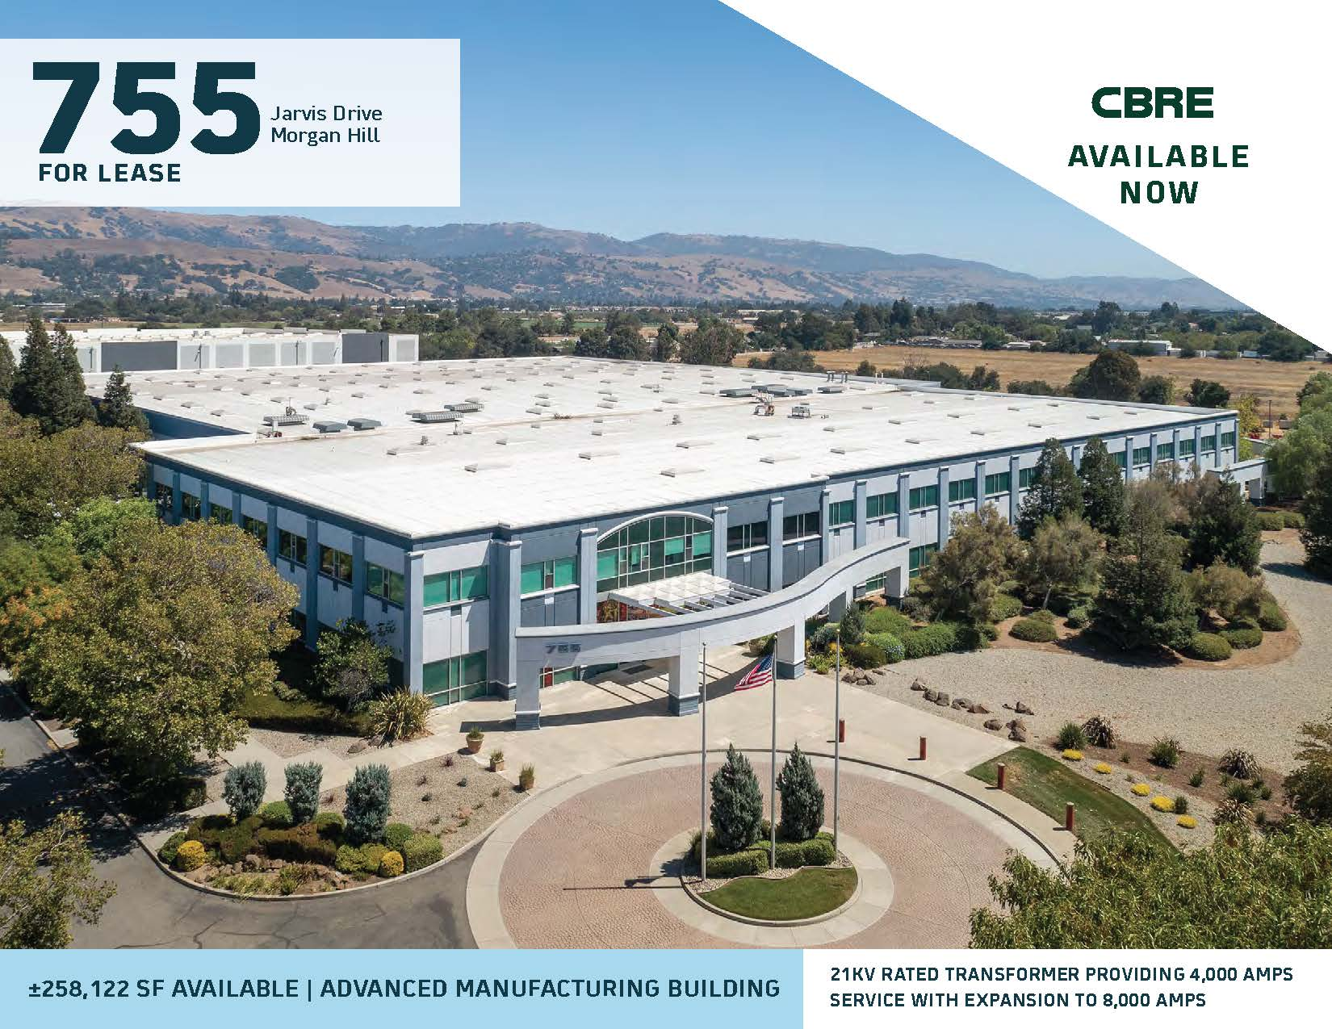
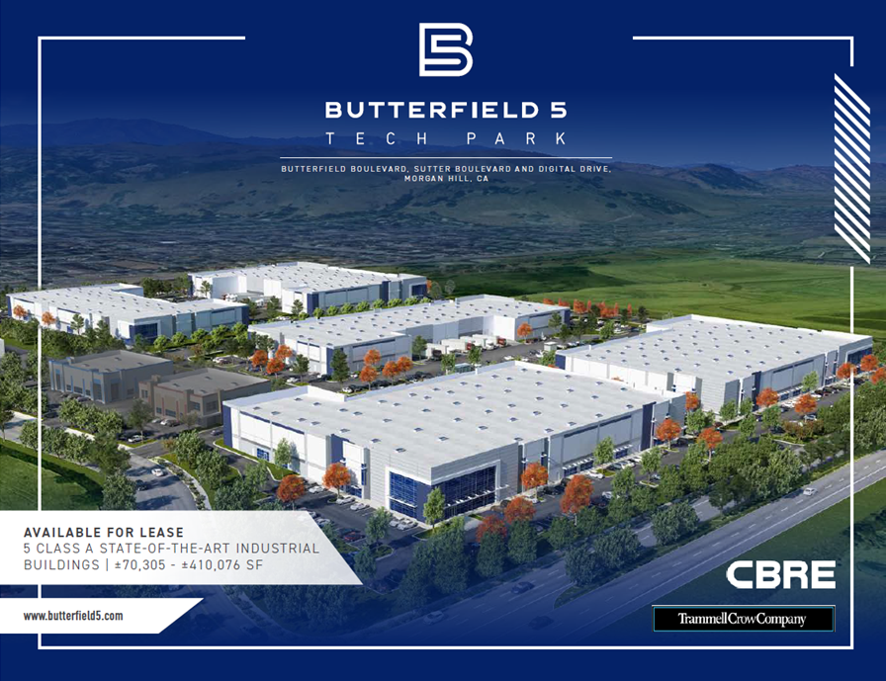
INDUSTRIAL WORK PLAN
2022 Accomplishments:
Adopted Industrial Preservation & Optimization Policy
Prohibited Fulfillment Centers and Sorting Center Uses
Expanded Medical Uses
2023 Goals:
Attract Innovation, Advanced Manufacturing, and R&D companies
Market and promote Morgan Hill
Support entitlement and permitting of industrial assets
Support the tenanting of industrial assets as they become available

